Slide 1
JavaScript – The definitive Guide
Chen Ken 2012/07/30

Slide 2
Agenda
CORE JavaScript
Lexical Structure
Types, Values and Variables
Expressions and Operators
Statements
Objects
Arrays
Functions
Classes and Modules
Regular expression
Server-Side JavaScript

Slide 3
Agenda
Client-Side JavaScript
JavaScript in Web Browsers
The Windows Object
Scripting Documents
Scripting CSS
Handling Events
Scripted HTTP
The jQuery Library
Client-Side Storage
Script media and Graphics
HTML5 API

Slide 4
CORE JavaScript

Slide 5
What is JavaScript
Is the programming language of the Web created by Netscape
Is a high-level, dynamic, untyped interpreted programming language that is well-suited to object-oriented and functional programming styles
Derives its syntax from Java, its first-class functions from Scheme, and its prototype-based inheritance from Self
Its Language standard - European Computer Manufacturer’s Association (ECMAScript), the latest version is ES5
Work seamlessly with HTML, CSS frontend techniques
Need JavaScript Virtual Machine to execute the code
Automatically garbage collected

Slide 6
Lexical Structure
Character Set
JavaScript programs are written using the Unicode character set
JavaScript is a case-sensitive language
HTML is not case-sensitive (XHTML is)
Many client-side JavaScript objects and properties have the same names as the HTML tags and attributes they represent. While these tags and attribute names can be typed in any case in HTML, in JavaScript they typically must be all lowercase. For example, in HTML onclick or onClick can be used for event handler, but must be specified as onclick in JavaScript code (or in XHTML documents)
Comments
// This is a single-line comment.
/* This is also a comment */ // and here is another comment.
/* * This is yet another comment. * It has multiple lines. */

Slide 7
Lexical Structure
Literals
12, 1.2 // The number twelve and one point two
"hello world" // A string of text
'Hi' // Another string
true, false // Boolean value
/javascript/gi // A "regular expression" literal
null // Absence of an object
{ x:1, y:2 } // An object initializer
[1,2,3,4,5] // An array initializer
Optional Semicolons
Although sometime semicolons can be omitted, it is preferred to always end a statement by semicolon

Slide 8
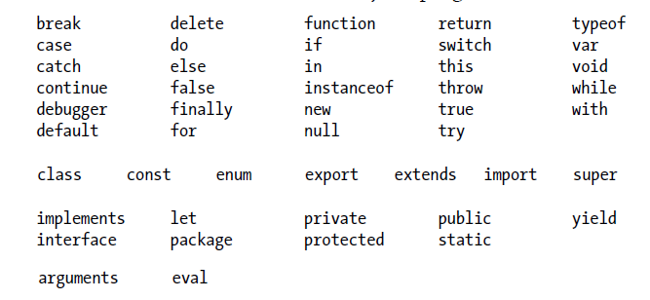
Lexical Structure
Identifiers
A JavaScript identifier must begin with a letter, an underscore (_), or a dollar sign ($). Subsequent characters can be letters, digits, underscores, or dollar signs
Reserved Words

Slide 9
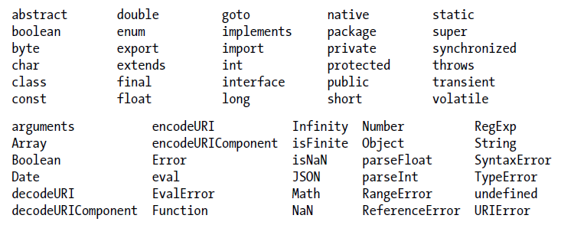
Lexical Structure
Reserved Words
Keep in mind that JavaScript implementations may define other global variables and functions, and each specific JavaScript embedding (client-side, server-side, etc.) will have its own list of global properties

Slide 10
Types, Values, and Variables
primitive types
Numbers
strings of text (known as strings)
Boolean
Two special primitives: null and undefined
object types
Is a collection of properties, where each property has a name and a value
User defined Class
Array/Function/Date/RegExp/Error built-in classes

Slide 11
Types, Values, and Variables
primitive types (immutable)
Numbers
strings of text (known as strings)
Boolean
Two special primitives: null and undefined
object types (mutable)
Is a collection of properties, where each property has a name and a value
User defined Class
Array/Function/Date/RegExp/Error built-in classes

Slide 12
Types, Values, and Variables
Numbers
Does not make a distinction between integer values and floating-point values. All numbers in JavaScript are represented as floating-point values (like Perl)
ECMAScript standard does not support integer literals in octal, but some JavaScript implementation may support them
Math/Number object
Arithmetic in JavaScript does not raise errors in cases of overflow (Infinity), underflow(-Infinity), or division by zero
0/0, divide infinity by infinity, Square root of a negative number, Use arithmetic operators with non-numeric operands that cannot be converted to numbers => NaN (Not-a-Number)

Slide 13
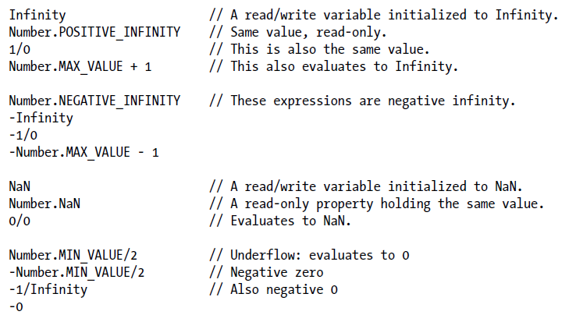
Types, Values, and Variables
Numbers
The NaN value doesn’t compare equal to any other value, including itself. Use isNaN(x) or x != x to determine if x is NaN
isFinite(x) returns true if x is not NaN, Infinity, -Infinity

Slide 14
Types, Values, and Variables
Binary Floating-Point and Rounding Errors
Binary floating-point representations cannot exactly represent numbers as simple as 0.1
var x = .3 - .2; // thirty cents minus 20 cents var y = .2 - .1; // twenty cents minus 10 cents x == y // => false: the two values are not the same! x == .1 // => false: .3-.2 is not equal to .1 y == .1 // => true: .2-.1 is equal to .1

Slide 15
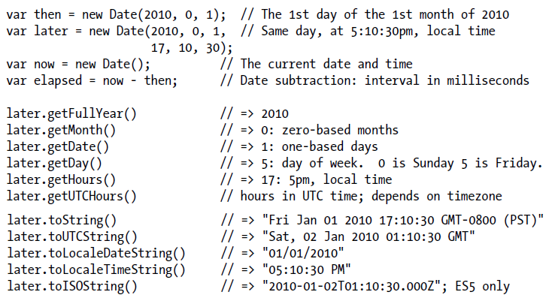
Types, Values, and Variables
Dates and Times

Slide 16
Types, Values, and Variables
String (utf-16 encoding of the Unicode character set)
A string is an immutable ordered sequence of 16-bit values, each of which typically represents a Unicode character
The length of a string is the number of 16-bit values it contains. JavaScript’s strings (and its arrays) use zero-based indexing
There is no Char type in JavaScript (As in Python)
String literals
"" // The empty string: it has zero characters
'testing‘
'name="myform"‘
"Wouldn't you prefer O'Reilly's book?“
"one\ // ECMAScript 5 only long\ line"

Slide 17
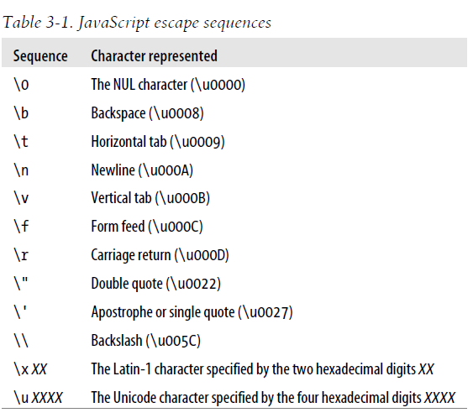
Types, Values, and Variables
Escape Sequences in String Literals

Slide 18
Types, Values, and Variables
Working with Strings
S = "Hello, " + "world"; // Produces the string "Hello, world“
s.length
s.charAt(0) // => "h": the first character
s.charAt(s.length-1) // => "d": the last character.
s.substring(1,4) // => "ell": the 2nd, 3rd and 4th characters.
s.slice(1,4) // => "ell": same thing
s.slice(-3) // => "rld": last 3 characters
s.indexOf("l") // => 2: position of first letter l.
s.lastIndexOf("l") // => 10: position of last letter l.
s.indexOf("l", 3) // => 3: position of first "l" at or after 3
s.split(", ") // => ["hello", "world"] split into substrings
s.replace("h", "H") // => "Hello, world": replaces all instances
s.toUpperCase() // => "HELLO, WORLD"

Slide 19
Types, Values, and Variables
Boolean
Any JavaScript value can be converted to a boolean value
The following values convert to, and therefore work like, false. All other values, including all objects (array) will convert to true undefined, null, 0, -0, NaN, “” empty string
Pay attention to your expression while dealing with boolean if (obj !== null) … if (obj) …
null and undefined
null is a keyword in JavaScript. “typeof (null)” return object
undefined is a predefined global var, “typeof(undefined)” returns undefined. It is used to represent a deeper kind of absence: value var which is not inited or value we get when querying property of an object or array which doesn’t exist or the returned value of a func which has no return value or the value of func paramenter for which no argument is supplied
When assigning to var or property or pass as arguments, prefer null

Slide 20
Types, Values, and Variables
The Global Object
When the JavaScript interpreter starts (or whenever a web browser loads a new page), it creates a new global object and gives it an initial set of properties that define
global properties like undefined, Infinity, and NaN
global functions like isNaN(), parseInt(), eval()
constructor functions like Date(), RegExp(), String(), Object(), and Array()
global objects like Math and JSON
In top-level code—JavaScript code that is not part of a function—you can use the JavaScript keyword this to refer to the global object: var global = this; // Define a global var to refer to the global object
In client-side JavaScript, the Window object serves as the global object for all JavaScript code contained in the browser window it represents. This object has a self-referential window property that can be used instead of this to refer to the global object

Slide 21
Types, Values, and Variables
Wrapper Objects
String()/Number()/Boolean()
JavaScript does the conversion if necessary: var s = “hello world!”; // JS converts s to a String object first, // then access the properties and then die var word = s.substring(1, s.length); // Use String properties var s = "test"; // Start with a string value s.len = 4; // Set a property on it. var t = s.len; // Now query the property, will have “undefined” result

Slide 22
Types, Values, and Variables
Immutable Primitive Values and Mutable Object References
All primitives are immutable
Primitives are also compared by value: two values are the same only if they have the same value. If two distinct string values are compared, JavaScript treats them as equal if, and only if, they have the same length and if the character at each index is the same
Objects are mutable
Objects are not compared by value: two objects are not equal even if they have the same properties and values var o = {x:1}, p = {x:1}; // Two objects with the same properties o === p // => false: distinct objects are never equal
Objects are compared by reference: two object values are the same if and only if they refer to the same underlying object: var a = []; var b = a; b[0] = 1; a === b

Slide 23
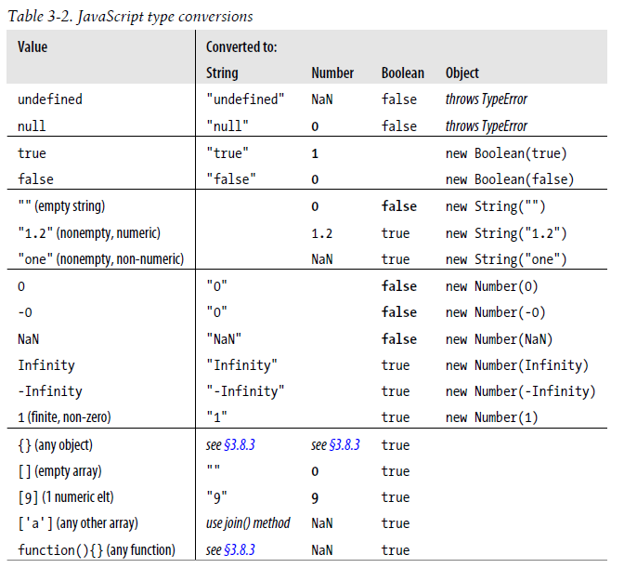
Type conversion (Like Perl)

Slide 24
Types, Values, and Variables
Conversion and equality
null == undefined // These two values are treated as equal
"0" == 0 // String converts to a number before comparing
0 == false // Boolean converts to number before comparing
"0" == false // Both operands convert to numbers before comparing
Explicit Conversions
Number("3") // => 3
String(false) // => "false" Or use false.toString()
Boolean([]) // => true
Object(3) // => new Number(3)
Note that any value other than null or undefined has a toString() method and the result of this method is usually the same as that returned by the String() function

Slide 25
Types, Values, and Variables
Object to Primitive Conversions
All objects inherit two conversion methods.
toString(), is to return a string representation of the object. The default toString() method does not return a very interesting value
valueOf(), is supposed to convert an object to a primitive value that represents the object, if any such primitive value exists, but objects are compound values, and most objects cannot really be represented by a single primitive value, so the default valueOf() method simply returns the object itself rather than returning a primitive

Slide 26
Types, Values, and Variables
Object to string Conversions steps:
If the object has a toString() method, JavaScript calls it. If it returns a primitive value, JavaScript converts it to a string (table 3-2)
If the object has no toString() method, or if that method does not return a primitive value, then JavaScript looks for a valueOf() method. If the method exists, JavaScript calls it. If it returns a primitive value, JavaScript converts it to a string (table 3-2)
Otherwise, JavaScript cannot obtain a primitive value from either toString() or valueOf(), so it throws a TypeError

Slide 27
Types, Values, and Variables
Object to number Conversions steps (valueOf first):
If the object has a valueOf() method that returns a primitive value, JavaScript converts (if necessary) that primitive value to a number (table 3-2)
Otherwise, if the object has a toString() method that returns a primitive value JavaScript converts (table 3-2)
Otherwise, JavaScript throws a TypeError

Slide 28
Types, Values, and Variables
Variable Declaration (Use var keyword)
var i; # initial value is “undefined”
var message = "hello";
Message = 10;
var i = 0, j = 0, k = 0;
for(var i = 0; i < 10; i++) console.log(i);
for(var p in o) console.log(p);
Repeated and Omitted Declarations
It is legal and harmless to declare a variable more than once with the var statement
If attempt to read the value of an undeclared variable, JavaScript generates an error. In ECMAScript 5 strict mode, it is also an error to assign a value to an undeclared variable (Historically, in non-strict mode, if assigning a value to an undeclared variable, JavaScript actually creates that variable as a property of the global object, and it works much like properly declared global variable)

Slide 29
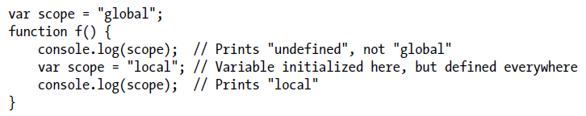
Types, Values, and Variables
Variable Scope
Within the body of a function, a local variable takes precedence over a global variable with the same name
Function Scope and Hoisting
JavaScript has no block scope as in C/C++ {}, it has function scope instead: variables are visible within the function in which they are defined and within any functions that are nested within that function
JavaScript’s function scope means that all variables declared within a function are visible throughout the body of the function. JavaScript code behaves as if all variable declarations in a function (but not any associated assignments) are “hoisted” to the top of the function

Slide 30
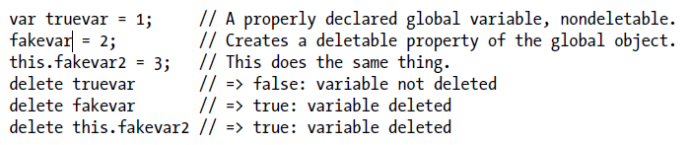
Types, Values, and Variables
Variables As Properties
When declaring a global JavaScript variable, what you are actually doing is defining a property of the global object. If you use var to declare the variable, the property that is created is nonconfigurable, which means that it cannot be deleted with the delete operator
if you’re not using strict mode and you assign a value to an undeclared variable, JavaScript automatically creates a global variable for you. Variables created in this way are regular, configurable properties of the global object and they can be deleted

Slide 31
Types, Values, and Variables
Scope chain (closure)
JavaScript uses scope chain to do variable name resolution (lookup). The scope chain is a list of list or chain of objects that defines the variables that are “in scope” for that code. The latest called function is always the head of the scope chain:
For e.g -> a() -> b() -> c(), the scope chain will be as below. So if in function c, the code is accessing a variable x, the JavaScript engine will look x in ScopeObjectC first, if it does not find there, the engine will look x in the next scope object in the chain, ScopeObjectB in this case, and finally will reach ScopeObjectGlobal which is for global scope if necessary and if still can’t find x, the engine will throw a ReferenceError
ScopeObjectC -> ScopeObjectB -> ScopeObjectA -> ScopeObjectForGlobal

Slide 32
Expressions and Operators
Expression
“hello”, /pattern/, true, i // primary expression
[], [1,2,3], var sparseArrary = [1,,,4] // array init
var p = {x: 1, y: 2}; var q = {} // Objects init
q.x = 1; q.y = 2 // same as p
var rect = { upperLeft: { x: 2, y: 2 }, lowRight: {x: 4, y: 5 }};
var square = function (x) { return x * x ; } // function def
Property Access
expression . Identifier
expression [ expression ] var p = { x: 1, y: { z: 3}}; // Consider Everything is hashtable var a = [p, 4, [5, 6]]; p.x, p.y.z, p[“x”], a[2][“1”], a[0].x

Slide 33
Expressions and Operators
Property Access
If the property name is a reserved word or includes spaces or punctuation characters, or when it is a number (for arrays), you must use the square bracket notation
Invocation
f(0);
Math.max(x, y, z); // method invocation
a.sort(); // method invocation
In method invocations, the object or array that is the subject of the property access becomes the value of the this parameter while the body of the function is being executed
Invocation expressions that are not method invocations normally use the global object as the value of the this keyword. In ECMAScript 5, however, functions that are defined in strict mode are invoked with undefined as their this value rather than the global object

Slide 34
Expressions and Operators
Object creation
new Object() or new Object; // () can be omitted if no params
new Point(1, 2)
JavaScript operators

Slide 35
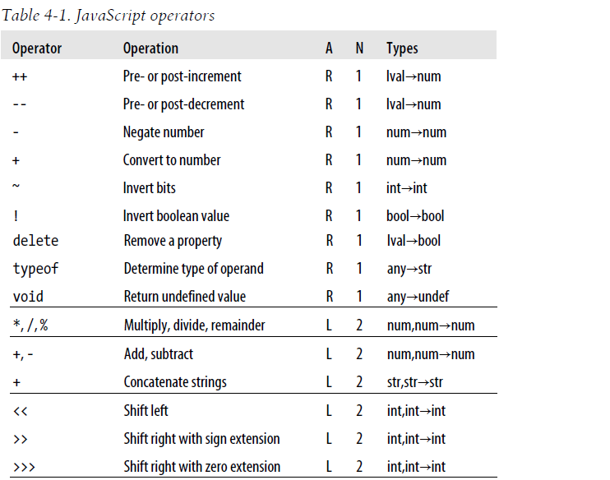
Expressions and Operators
JavaScript operators

Slide 36
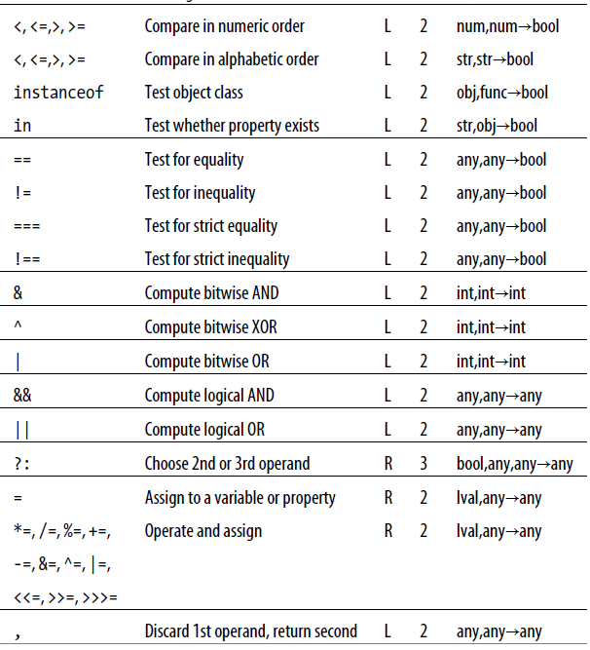

Slide 37
Expressions and Operators
Strict Equality operator (===)
The strict equality operator === evaluates its operands, and then compares the two values as follows, performing no type conversion
If the two values have different types, they are not equal
If both values are null or both values are undefined, they are equal
If both values are the boolean value true or both are the boolean value false, they are equal
If one or both values is NaN, they are not equal
If both values are numbers and have the same value, they are equal. If one value is 0 and the other is -0, they are also equal
If both values are strings and contain exactly the same 16-bit values in the same positions, they are equal
If both values refer to the same object, array, or function, they are equal. If they refer to different objects they are not equal, even if both objects have identical properties

Slide 38
Expressions and Operators
Equality operator (==)
If the values of the two operands are not the same type, it attempts some type conversions and tries the comparison again:
If the two values have the same type, test them for strict equality as described above
If the two values do not have the same type, the == operator may still consider them equal. Use the following rules and type conversions to check for equality:
If one value is null and the other is undefined, they are equal
If one value is a number and the other is a string, convert the string to a number and try the comparison again, using the converted value
If either value is true, convert it to 1 and try the comparison again. If either value is false, convert it to 0 and try the comparison again
If one value is an object and the other is a number or string, convert the object to a primitive and try the comparison again
Any other combinations of values are not equal

Slide 39
Expressions and Operators
Comparison Operators (<, >, <=, >=)
The operands of these comparison operators may be of any type. Comparison can be performed only on numbers and strings, however, so operands that are not numbers or strings are converted. Comparison and conversion occur as follows :
If either operand evaluates to an object, that object is converted to a primitive value.
If, after any required object-to-primitive conversion, both operands are strings, the two strings are compared, using alphabetical order
If, after object-to-primitive conversion, at least one operand is not a string, both operands are converted to numbers and compared numerically. If either operand is (or converts to) NaN, then the comparison operator always returns false

Slide 40
Expressions and Operators
The in operator
It expects a left-side operand that is or can be converted to a string. It expects a right-side operand that is an object. It evaluates to true if the left-side value is the name of a property of the right-side object var point = { x:1, y:1 }; // Define an object "x" in point // => true: object has property named "x“ "z" in point // => false: object has no "z" property
The instance of operator
It expects a left-side operand that is an object and a right-side operand that identifies a class (A.K.A constructor (function)) of objects. It evaluates to true if the left-side object is an instance of the right-side class and evaluates to false otherwise. var d = new Date(); // Create a new object with the Date() constructor d instanceof Date; // true; d was created with Date() d instanceof Object; // true; all objects are instances of Object d instanceof Number; // false

Slide 41
Expressions and Operators
eval()
It expects one argument. If you pass any value other than a string, it simply returns that value. If you pass a string, it attempts to parse the string as JavaScript code, throwing a SyntaxError if it fails. If it successfully parses the string, then it evaluates the code and returns the value of the last expression or statement in the string or undefined if the last expression or statement had no value. If the string throws an exception, the eval() propagates that expression
it uses the variable environment of the code that calls it. That is, it looks up the values of variables and defines new variables and functions in the same way that local code does
declare a local function: eval("function f() { return x+1; }");

Slide 42
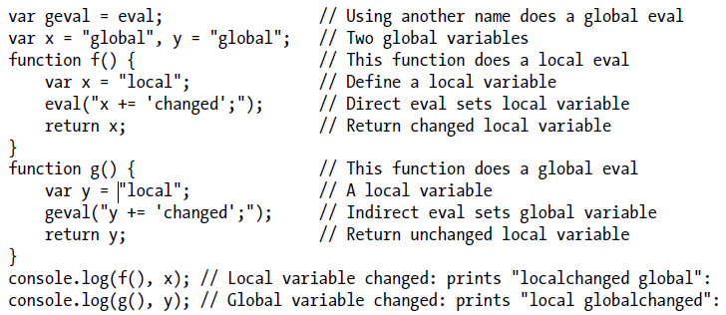
Expressions and Operators
Global eval()
ECMAScript 5: Direct calls to eval() use the variable environment of the calling context. Any other call—an indirect call—uses the global object as its variable environment and cannot read, write, or define local variables or functions

Slide 43
Expressions and Operators
Strict eval()
ECMAScript 5 strict mode: When eval() is called from strict mode code, or when the string of code to be evaluated itself begins with a “use strict” directive, then eval() does a local eval with a private variable environment. This means that in strict mode, evaluated code can query and set local variables, but it cannot define new variables or functions in the local scope
strict mode makes eval() even more operator-like by effectively making “eval” into a reserved word. You are not allowed to overwrite the eval() function with a new value. And you are not allowed to declare a variable, function, function parameter, or catch block parameter with the name “eval”

Slide 44
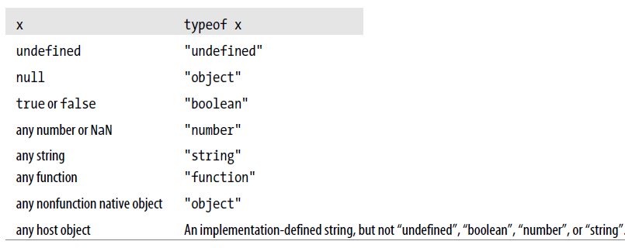
Expressions and Operators
The typeof operator
It returns a string which specifies the type of the operand

Slide 45
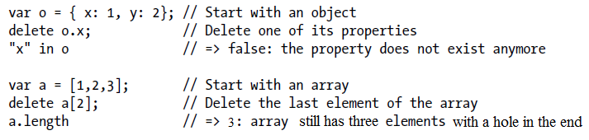
Expressions and Operators
The delete operator
It attempts to delete the object property or array element
Note that a deleted property or array element is not merely set to the undefined value. When a property is deleted, the property ceases to exist
delete expects its operand to be an lvalue. If it is not an lvalue, the operator takes no action and returns true.
Otherwise, delete attempts to delete the specified lvalue returning true if success

Slide 46
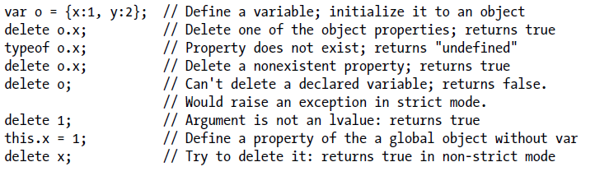
Expressions and Operators
Example of delete operator

Slide 47
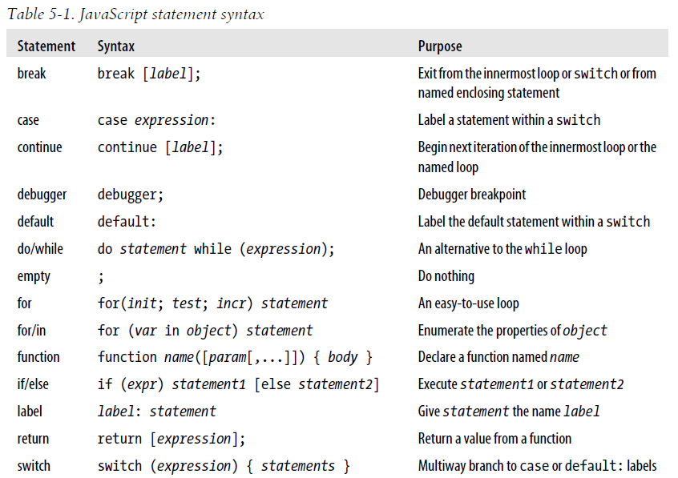
Statements

Slide 48
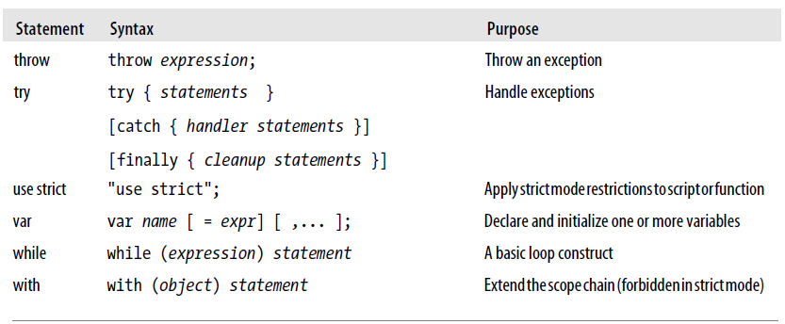
Statements

Slide 49
Object
Terms of three categories of objects and two types of properties
native object: is an object or class of objects defined by the ECMAScript specification, say Arrays, functions, dates, and regular expressions
host object: is an object defined by the host environment (such as a web browser) within which the JavaScript interpreter is embedded. Say, The HTMLElement objects that represent the structure of a web page in client-side JavaScript are host objects. Host objects may also be native objects.
user-defined object: is any object created by the execution of JavaScript code
own property: is a property defined directly on an object
inherited property: is a property defined by an object’s prototype object

Slide 50
Object
Object creation
Objects can be created with object literals, with the new keyword and (in ES5) with the Object.create() function
Object can be treated as a hashtable containing key/value pair
Prototype
Every JavaScript object has a second JavaScript object, called prototype (or null but this is rare) associated with it. The object inherits properties from the prototype
All objects created by object literals have the same prototype object, called Object.prototype
Objects created using the new keyword and a constructor invocation use the value of the prototype property of the constructor function as their prototype, say Array.prototype, Date.prototype
Object.prototype is one of the rare objects that has no prototype
All of the built-in constructors (and most user-defined constructors) have a prototype that inherits from Object.prototype

Slide 51
Object
Object.create()
ES5 defines Object.create(), that creates a new object, using its first argument as the prototype of that object. It also takes an optional second argument that describes the properties of the new object. It is a static function, not a method invoked on individual objects var o1 = Object.create({x:1, y:2}); // o1 inherits properties x and y. var o2 = Object.create(null); // o2 inherits no props or methods. // o3 is like {} or new Object(). var o3 = Object.create(Object.prototype);

Slide 52
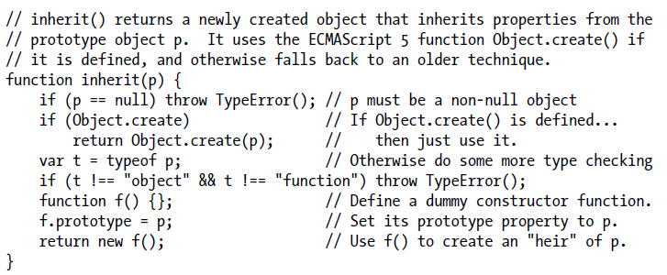
Object
Inherit
for/in traverse the properties of object
for(stock in portfolio) { var shares = portfolio [stock]; }

Slide 53
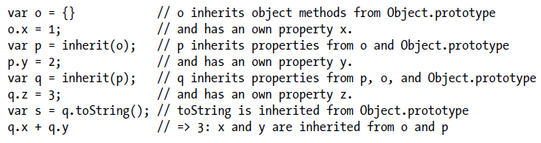
Object
Inheritance
Object.prototype
o
p
q
prototype = NULL
prototype
prototype
prototype
toString …
x
y
z

Slide 54
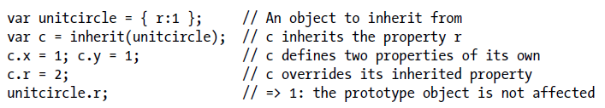
Object
Inheritance
Property assignment examines the prototype chain to determine whether the assignment is allowed. If o inherits a read-only property named x, for example, then the assignment is not allowed. If the assignment is allowed, however, it always creates or sets a property in the original object and never modifies the prototype chain (which means other objects which inherits the same prototype will not see the changes)
The fact that inheritance occurs when querying properties but not when setting them is a key feature of JavaScript because it allows us to selectively override inherited properties.

Slide 55
Object
Inheritance
There is one exception to the rule that a property assignment either fails or creates or sets a property in the original object. If o inherits the property x, and that property is an accessor property with a setter method, then that setter method is called rather than creating a new property x in o. Note, however, that the setter method is called on the object o, not on the prototype object that defines the property, so if the setter method defines any properties, it will do so on o, and it will again leave the prototype chain unmodified
Modifying the prototype directly will impact all the object which inherit this prototype

Slide 56
Object
An attempt to set a property p of an object o fails in these circumstances:
o has an own property p that is read-only: it is not possible to set read-only properties (See the defineProperty() method, however, for an exception that allows configurable read-only properties to be set)
o has an inherited property p that is read-only: it is not possible to hide an inherited read-only property with an own property of the same name
o does not have an own property p; o does not inherit a property p with a setter method, and o’s extensible attribute is false

Slide 57
Object
Deleting Properties
delete does not operate on the value of the property but on the property itself.
The delete operator only deletes own properties, not inherited ones (To delete an inherited property, you must delete it from the prototype object in which it is defined. Doing this affects every object that inherits from that prototype.)
delete does not remove properties that have a configurable attribute of false

Slide 58
Object
Testing Properties
in operator, return true if the object has an own property or an inherited property by that name
hasOwnProperty() method of an object tests whether that object has an own property with the given name
propertyIsEnumerable() returns true only if the named property is an own property and its enumerable attribute is true

Slide 59
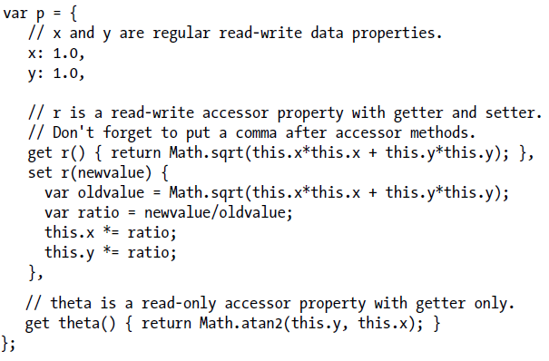
Object
Property Getters and Setters (accessor property)
Accessor properties do not have a writable attribute as data properties do. If a property has both a getter and a setter method, it is a read/write property. If it has only a getter method, it is a read-only property. And if it has only a setter method, it is a write-only property and attempts to read it always evaluate to undefined

Slide 60
Object
Property Attributes
Value: Property value
Writable: specifies whether the value of the property can be set
Enumerable: specifies whether the property name is returned by a for/in loop
Configurable: specifies whether the property can be deleted and whether its attributes can be altered
Data property descriptor: value, writable, enumerable, configurable
Accessor property descriptor: get, set, enumerable, configurable
Object.getOwnPropertyDescriptor()
Object.defineProperty()
Object.defineProperties()

Slide 61
Object
Rules of Object.defineProperty()
If an object is not extensible, you can edit its existing own properties, but you cannot add new properties to it
If a property is not configurable, you cannot change its configurable or enumerable attributes
If an accessor property is not configurable, you cannot change its getter or setter method, and you cannot change it to a data property
If a data property is not configurable, you cannot change it to an accessor property
If a data property is not configurable, you cannot change its writable attribute from false to true, but you can change it from true to false
If a data property is not configurable and not writable, you cannot change its value. You can change the value of a property that is configurable but nonwritable, however

Slide 62
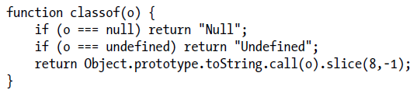
Object
Object attributes:
object’s prototype: is a reference to another object from which properties are inherited
Object.getPrototypeOf() / o.constructor.prototype
Object.isPrototypeOf
object’s class: is a string that categorizes the type of an object
object’s extensible flag: specifies (in ES5) whether new properties may be added to the object
Object.isExtensible() / Object.preventExtensions()
Object.seal() / Object.isSealed()
Object.freeze() / Object.isFrozen()

Slide 63
Object
Serializing Objects
JSON.stringify()
JSON.parse()

Slide 64
Array
Array in JavaScript
JavaScript arrays are untyped: an array element may be of any type, and different elements of the same array may be of different types
JavaScript arrays are zero-based and use 32-bit indexes
JavaScript arrays are dynamic: they grow or shrink as needed
JavaScript arrays may be sparse: the elements need not have contiguous indexes and there may be gaps
JavaScript array has a length property. For sparse arrays, length is larger than the index of all elements
Array is an object in JavaScript (Note: Object is something like hash)

Slide 65
Array
Array creation
var a = new Array(); var c = new Array(10); var d = new Array(1, 2, 3, ‘Testing’); var cnt = [1,,3]; var b = [[1, {x:1, y:2}], [2, {x:3, y:4}]];
Access to the element
a[1] = “one”;
a[-1.23] = “two”; // create a property with the name “-1.23”
a[1.000] = “three”; // a[1] is now “three”
a[“1000”] = “four”; // the 1001th element is four
Note, we can use index or property name of the array to access the element in array, treat index as a special kind of property of array. When using index to manipulate the array, the length property of the array will be updated if necessary.

Slide 66

Array
Sparse Array
var a = new Array(5); // No elements, but a.length is 5. a = []; // no elements and length = 0. a[1000] = 0; // adds one element but sets length to 1001.
Sparse array is slow than nonsparse array
Note that when you omit value in an array literal, you are not creating a sparse array. The omitted element exists in the array and has the value undefined
But note that, a1[1,,,,,,8] is sparse, but some JavaScript implementation insert ‘undefined’ in between.

Slide 67
Array
The length of Array
var a = [] // length is 0
a [0] = 0; a [1] = 1 ; a [2] = 2 ; // length is 3
a.length = 2; // a is [0, 1] now
a.length = 0; // a is [] now
a.length = 5; // no element, like new Array (5)
You can also set the length property of an array to a value larger than its current value. Doing this does not actually add any new elements to the array, it simply creates a sparse area at the end of the array

Slide 68
Array
Adding and Deleting Array Elements
var a = [] // length is 0
a [0] = 0; a [1] = 1 ;
a.push(“two”);
a.push(“three”, “four”); // [0, 1, “two”, “three”, “four”]
delete a[1]; // a.length is still 5
1 in a; // false, 1 does not exists in the array any more
var p = pop (a); // a.length is 4

Slide 69
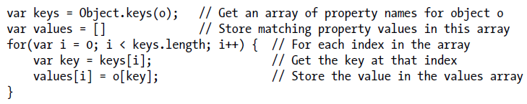
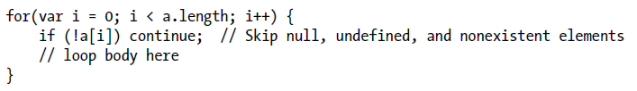


Array
Iterating Arrays

Slide 70
Array
Array Methods
Array.join // String.split
Array.reverse
Array.sort
Array.concat
Array.slice
Array.spice
Array.push/pop // act as stack
Array.unshift/shift // elements will be moved
Array.toString/toLocalString

Slide 71
Array
Array Methods in ES5 (Overview)
Most of the methods accept a function (callback) as their first argument and invoke the callback once for each element (or some elements) of the array.
If the array is sparse, the callback is not invoked for nonexistent elements.
Mostly, the callback is invoked with three arguments: the value of the array element, the index of the array element, and the array itself. Often you only need the first of these argument values and can ignore the second and third values.
If specifying the second argument, the callback is invoked as if it is a method of this second argument. That is, the second argument you pass becomes the value of the this keyword inside of the callback.
The return value of the function you pass is important, but different methods handle the return value in different ways.
None of the ES5 array methods modify the array on which they are invoked. But the callback may modify the array!

Slide 72
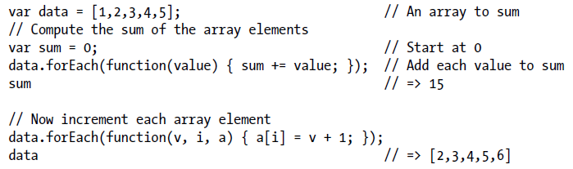
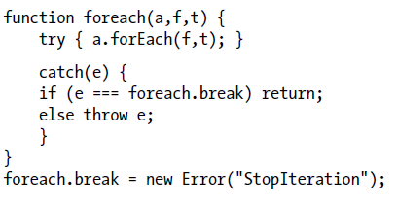
Array
Array Methods in ES5
forEach
Exit earlier before looping all elements

Slide 73
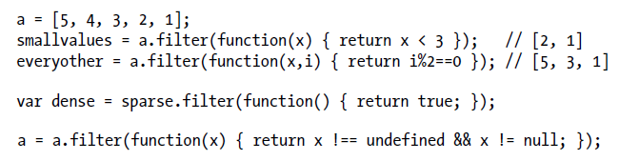
Array
Array Methods in ES5
Map // return an new array
Filter // return new array
Every()/some()
Reduce()/reduceRight()
indexOf/lastIndexOf()

Slide 74
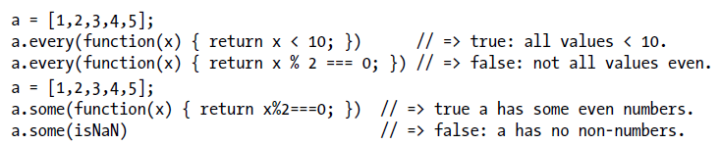

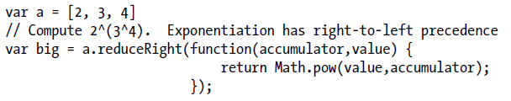
Array
Array Methods in ES5
every()/some()
Reduce()/reduceRight()

Slide 75


Array
Array type
ES5 introduces Array.isArray to test if an object is array type
In ES3, we need do (“obj instanceof Array” is not reliable enough due to inter-frame problem)
Inter-frame: The problem with using instanceof is that in web browsers, there can be more than one window or frame open. Each has its own JavaScript environment, with its own global object. And each global object has its own set of constructor functions. Therefore an object from one frame will never be an instance of a constructor from another frame.

Slide 76
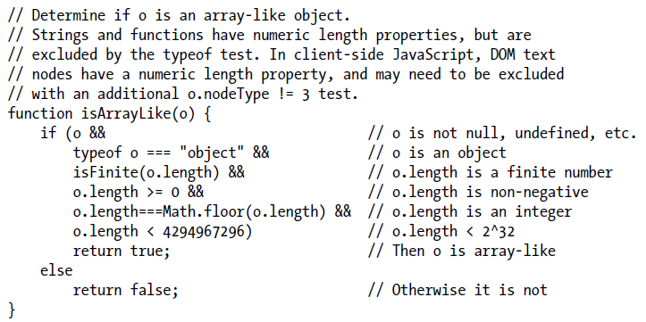
Array
Array special features
The length property is automatically updated as new elements are added to the list
Setting length to a smaller value truncates the array
Arrays inherit useful methods from Array.prototype
Arrays have a class attribute of “Array”
Array-Like objects (can work with array methods)

Slide 77
Function
Definition of function
function as the keyword var f = function fact(x) { // function name fact is optional if (x <= 1) return 1; else return x * fact (x - 1); }; f(4);
Functions are objects in JavaScript
JavaScript function definitions can be nested within other functions, and they have access to any variables that are in scope where they are defined (closures)

Slide 78
Function
4 ways to invoking functions
As functions
As methods
As constructors
Indirectly through their call() and apply() methods
Function Invocation
fact (4);
In ES3 and nonstrict ES5, the invocation context (the this value) is the global object. In strict mode, however, the invocation context is undefined
// Define and invoke a function to determine if we're in strict mode. var strict = (function() { return !this; }());

Slide 79
Function
Methods Invocation
o.m = f; o.m(); o[“m”]();
the object o becomes the invocation context for the above method invocation and the function body can refer to that object by using the keyword this
Any function that is used as a method is effectively passed an implicit argument—the object through which it is invoked
Method Chaining
When you write a method that does not have a return value of its own, consider having the method return this $(":header").map(function() { return this.id }).get().sort();

Slide 80
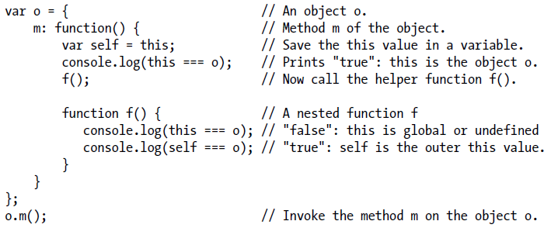
Function
This keyword
Note: this is a keyword in JavaScript, it is NOT a variable or property name. JavaScript syntax does not allow to assign a value to this
Unlike variables, the this keyword does not have a scope, and nested functions do NOT inherit the this value of their caller. If a nested function is invoked as a method, its this value is the object it was invoked on. If a nested function is invoked as a function then its this value will be either the global object or undefined
It is a common mistake to assume that a nested function invoked as a function can use this to obtain the invocation context of the outer function

Slide 81
Function
Constructors Invocation
if a constructor has no parameters, JavaScript constructor invocation syntax allows the argument list and parentheses to be omitted entirely var o = new Object(); var o = new Object;
A constructor invocation creates a new, empty object that inherits from the prototype property of the constructor
Constructor functions are intended to initialize objects and this newly created object is used as the invocation context new o.m(); // o is not used as the invocation context
If a constructor explicitly used the return statement to return an object, then that object becomes the value of the invocation expression
If the constructor uses return with no value, or if it returns a primitive value, that return value is ignored and the new object is used as the value of the invocation

Slide 82
Function
Indirect Invocation
JavaScript functions are objects and like all JavaScript objects, they have methods. Two of these methods, call() and apply(), invoke the function indirectly
They allow you to explicitly specify the this value for the invocation, which means you can invoke any function as a method of any object, even if it is not actually a method of that object

Slide 83
Function
Function Arguments and Parameters
JavaScript function definitions do not specify an expected type for the function parameters and function invocations do not do any type checking on the argument values passed in. JavaScript function invocations do not even check the number of arguments being passed
Optional parameters
When a function is invoked with fewer arguments than declared parameters, the additional parameters are set to the undefined value
Note that when designing functions with optional arguments, you should be sure to put the optional ones at the end of the argument list so that they can be omitted. We cannot omit the first argument and pass the second, we would have to explicitly pass undefined the first argument
Use the comment /* optional */ in the function definition to emphasize the fact that the parameter is optional

Slide 84
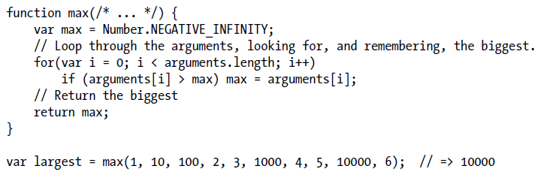
Function
The Arguments Object (varargs func)
Within the body of a function, the identifier arguments refers to the Arguments (array-like) object for that invocation
In ES5, in non-strict functions arguments is just an identifier. In strict mode, it is effectively a reserved word. Strictmode functions cannot use arguments as a parameter name or as a local variable name and they cannot assign values to arguments

Slide 85

Function
The Arguments Object (varargs func)
The Arguments object defines callee and caller properties In ES5 strict mode, these properties are guaranteed to raise a TypeError if you try to read or write them. Outside of strict mode, ES5 says that the callee property refers to the currently running function. caller is a nonstandard but commonly implemented property that refers to the function that called this one. The caller property gives access to the call stack and the callee property is occasionally useful to allow unnamed functions to call themselves recursively:
Remember to check the type of the argument passed in (good habit and best practice ?)

Slide 86
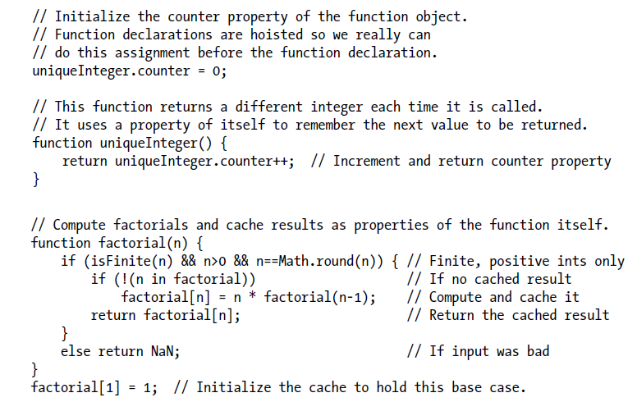
Function
Defining Your Own Function Properties

Slide 87

Function
Functions As Namespaces (idioms in JS)
Note the open parenthesis before function below is required because without it the JavaScript interpreter tries to parse the function keyword as a function declaration statement. With the parenthesis, the interpreter correctly recognizes this as a function definition expression. It is idiomatic to use the parentheses, even when they are not required, around a function that is to be invoked immediately after being defined

Slide 88
Function
Closure
Each time a JavaScript function is invoked, a new object is created to hold the local variables for that invocation, and that object is added to the scope chain. When the function returns, that variable binding object is removed from the scope chain. If there were no nested functions, there are no more references to the binding object and it gets garbage collected. If there were nested functions defined, then each of those functions has a reference to the scope chain, and that scope chain refers to the variable binding object. If those nested functions objects (only) remained within their outer function, however, then they themselves will be garbage collected, along with the variable binding object they referred to. But if the function defines a nested function and returns it or stores it into a property somewhere, then there will be an external reference to the nested function. It won’t be garbage collected, and the variable binding object it refers to won’t be garbage collected either

Slide 89
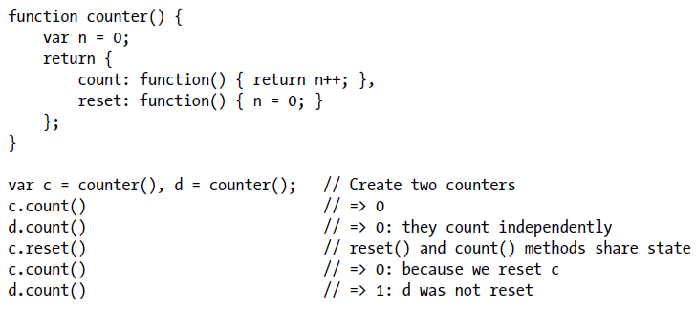
Function
Closure example
Note
Every function invocation has a this value, and a closure cannot access the this value of its outer function unless the outer function has saved that value into a variable: var self = this; // Save this value in a variable for use by nested funcs.
Same to the arguments object

Slide 90

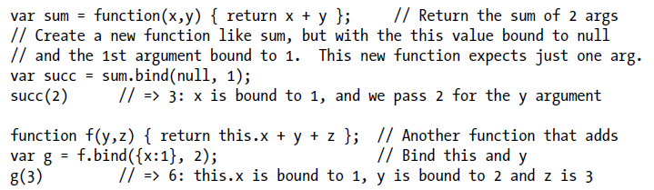
Function
Function Properties, Methods, and Constructor
The length Property (readonly, parameter list length)
The prototype Property
The call() and apply() Methods, call functions as methods of an object
The bind() Method

Slide 91
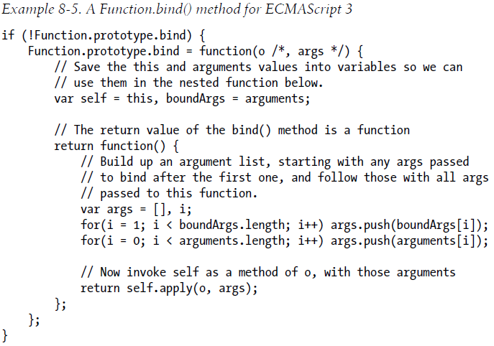
Function
Function Properties, Methods, and Constructor
The bind() Method implementation in ES3

Slide 92
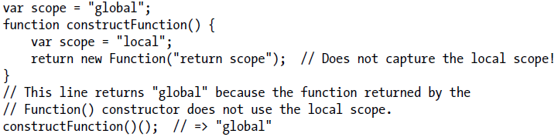
Function
Function Properties, Methods, and Constructor
The Function() Constructor var f = new Function("x", "y", "return x*y;"); almost equals to var f = function(x, y) { return x*y; }
The Function() constructor allows JavaScript functions to be dynamically created and compiled at runtime
The Function() constructor parses the function body and creates a new function object each time it is called (performance)
the functions it creates do not use lexical scoping; instead, they are always compiled as if they were top-level functions, as the following code demonstrates:

Slide 93
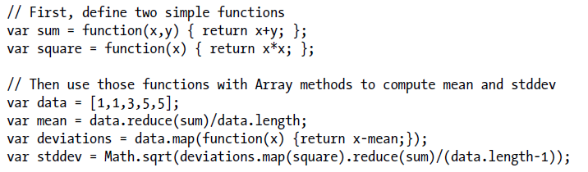
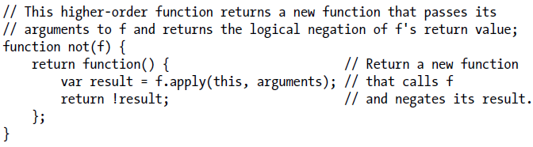
Function
Function programming
High order function
is a function that operates on functions, taking one or more functions as arguments and returning a new function

Slide 94
Classes and Modules
Class, prototype, constructor
In JavaScript, a class is a set of objects that inherit properties from the same prototype object
The critical feature of constructor invocations is that the prototype property of the constructor is used as the prototype of the new object (Usually we need define prototype property for the constructor)
By convention, the first character of the class name is upper case
The prototype object is fundamental to the identity of a class: two objects are instances of the same class if and only if they inherit from the same prototype object. The constructor function that initializes the state of a new object is not fundamental: two constructor functions may have prototype properties that point to the same prototype object. Then both constructors can be used to create instances of the same class.

Slide 95
Classes and Modules
Class, prototype, constructor
instanceof operator just checks if the object inherits from the specific prototype object
Any JavaScript function can be used as a constructor (aka, every JavaScript function (except functions returned by the ES5 Function.bind() method) automatically has a prototype property). The value of this property is an object that has a single nonenumerable constructor property. The value of the constructor property is the function object
The existence of this predefined prototype object with its constructor property means that objects typically inherit a constructor property that refers to their constructor

Slide 96
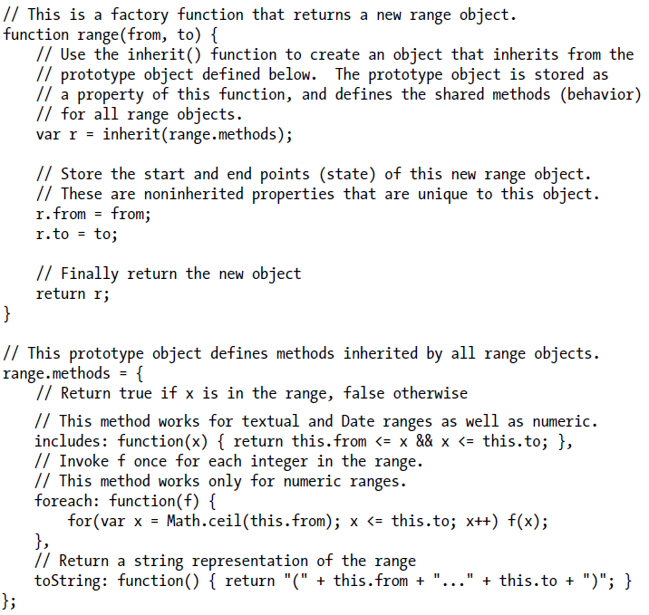
Classes and Modules

Slide 97
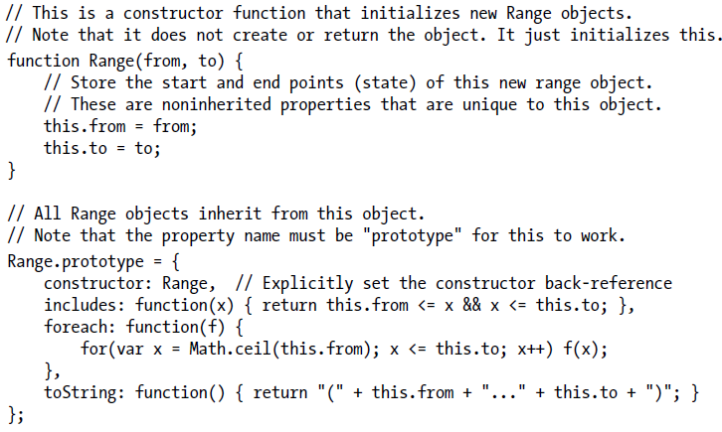
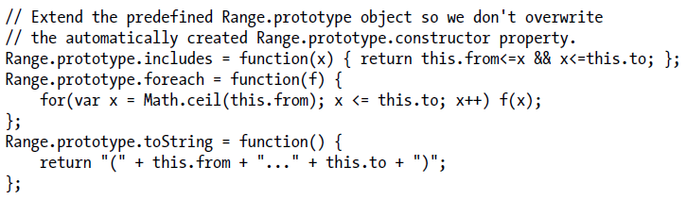
Classes and Modules

Slide 98
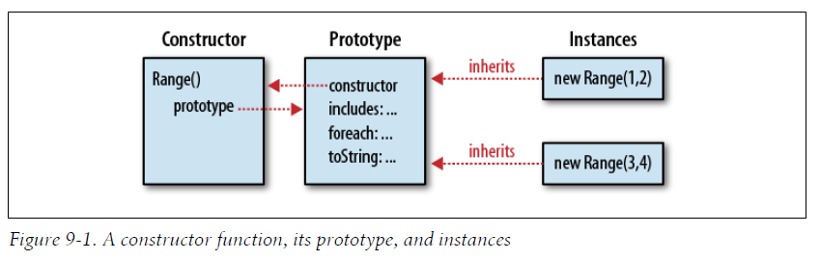
Classes and Modules

Slide 99
Classes and Modules
JavaScript class
In JavaScript, there are three different objects involved in any class definition
Constructor object the constructor function (an object) defines a name for a JavaScript class. Properties you add to this constructor object serve as class fields and class methods (like static memfunc in Java/C++/Python)
Prototype object The properties of this object are inherited by all instances of the class, and properties whose values are functions behave like instance methods of the class
Instance object Each instance of a class is an object in its own right, and properties defined directly on an instance are not shared by any other instances. Nonfunction properties defined on instances behave as the instance fields of the class

Slide 100
Classes and Modules
Three steps to define a class
First, write a constructor function that sets instance properties on new objects
Second, define instance methods on the prototype object of the constructor
Third, define class fields and class properties on the constructor itself
Augmenting the class
Again, note that all instance object of the same class share the same prototype object. If the prototype objects changes, it will impact all instance objects
We can change the functions/properties of prototype object to change the class

Slide 101
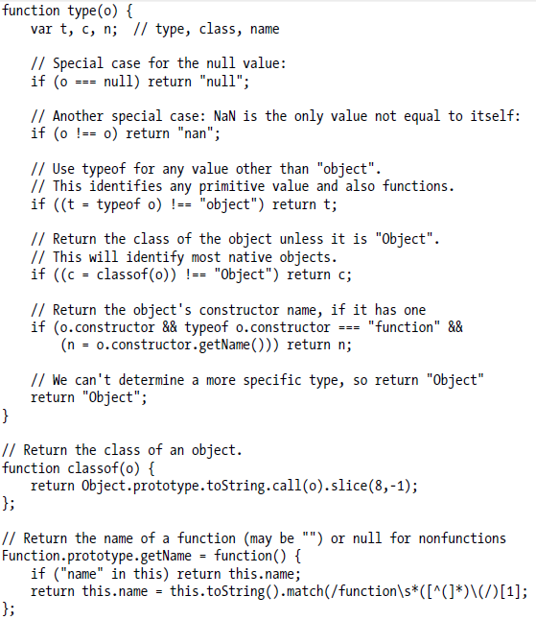
Classes and Modules

Slide 102
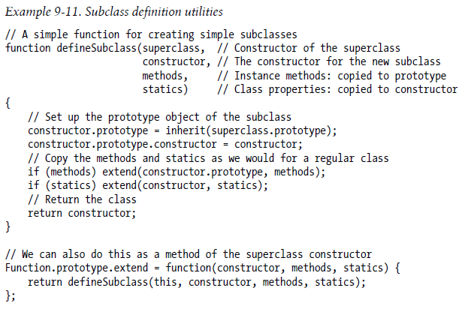
Classes and Modules
Subclasses
The key to creating subclasses in JavaScript is proper initialization of the prototype object. If class B extends A, then B.prototype must be an heir of A.prototype. Then instances of B will inherit from B.prototype which in turn inherits from A.prototype

Slide 103
Classes and Modules
Base Class
Base class Prototype object
Object class Prototype object
Prototype object ref
Prototype object ref
Prototype object ref = undefined
Instance properties of the prototype object
Instance properties of the prototype object
Instance properties
Class properties
Derived Class
Derived class Prototype object
Prototype object ref
Prototype object ref
Instance properties
Instance properties of the prototype object
Class properties

Slide 104
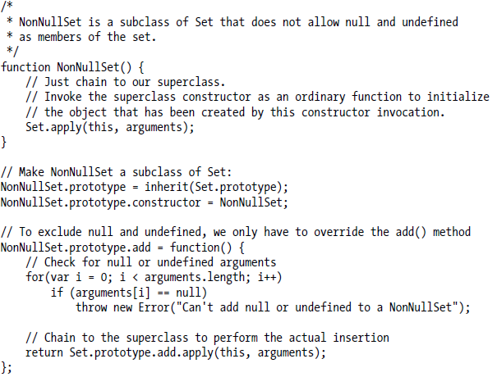
Classes and Modules
Calling methods of base class

Slide 105
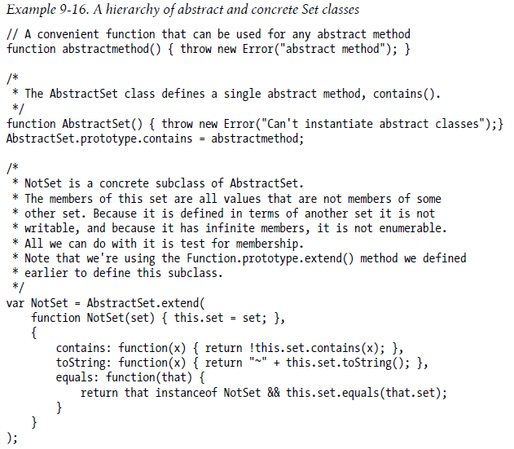
Classes and Modules
Mimic abstract class

Slide 106
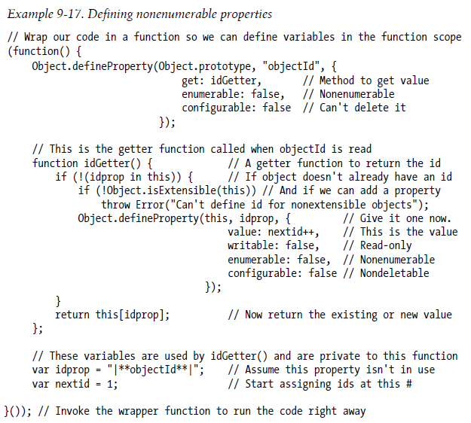
Classes and Modules
Making Properties Nonenumerable

Slide 107
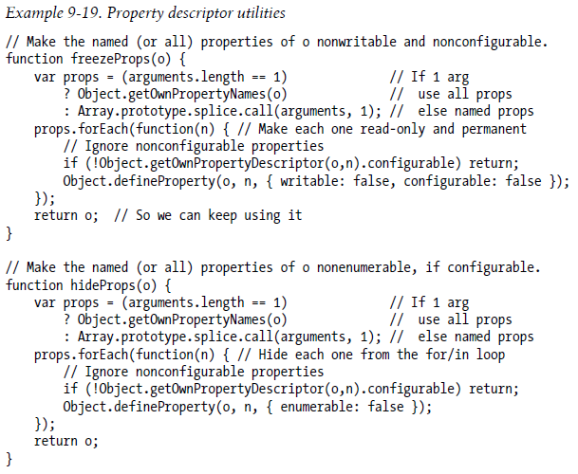
Classes and Modules
Defining Immutable Classes

Slide 108
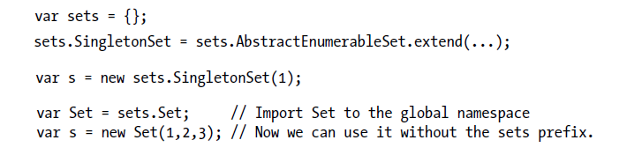
Classes and Modules
Modules
modules should minimize the number of global symbols they define—ideally, no module should define more than one
One way for a module to avoid the creation of global variables is to use an object as its namespace. Instead of defining global functions and variables, it stores the functions and values as properties of an object (which may be referenced by a global variable).

Slide 109
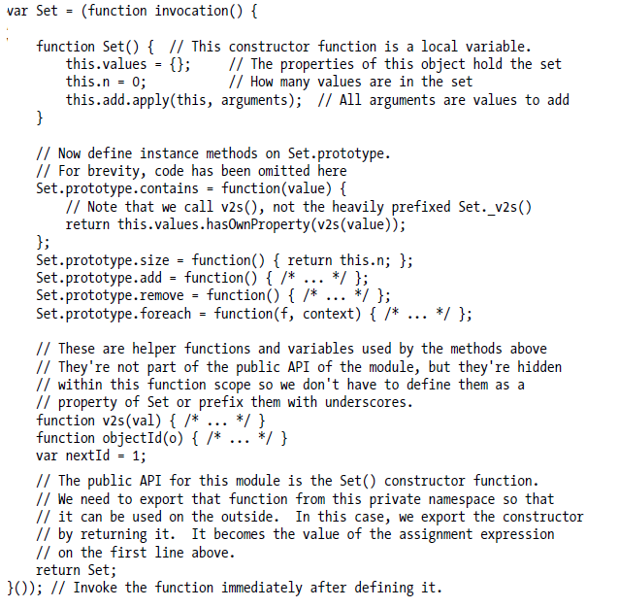
Function Scope As a Private Namespace

Slide 110

Function Scope As a Private Namespace

Slide 111

Regular expression
Regular object
RegExp() constructor
RegExp.source
RegExp.global
RegExp.ignoreCase
RegExp.multiline
RegExp.lastIndex
RegExp.exec()
RegExp.test()

Slide 112

Regular expression
Character Classes

Slide 113

Regular expression
Repetition (greedy)
Non-greedy repetition
Simply follow the repetition character or characters with a question mark: ??, +?, *?, or even {1,5}?

Slide 114

Regular expression
Alternation, Grouping, and References

Slide 115


Regular expression
Specifying Match Position
Regular expression Flags

Slide 116

Regular expression
String Methods for Pattern Matching
"JavaScript".search(/script/i);
text.replace(/javascript/gi, "JavaScript");
var quote = /"([^"]*)"/g; text.replace(quote, '“$1”');
"1 plus 2 equals 3".match(/\d+/g) // returns ["1", "2", "3"]
"123,456,789".split(","); // Returns ["123","456","789"]
"1, 2, 3, 4, 5".split(/\s*,\s*/); // Returns ["1","2","3","4","5"]

Slide 117
Server-Side JavaScript
Rhino
Written in Java
Enable JavaScript to access Java API
Node.js (Google V8 JS engine)
Written in C++
Asynchronous
Binding POSIX API underlying

Slide 118
Client-Side JavaScript

Slide 119
JavaScript in Web Browsers
Client-Side JavaScript
The Window object is the main entry point to all client-side JavaScript features and APIs. It represents a web browser window or frame, and you can refer to it with the identifier window
In client-side JavaScript, the Window object is also the global object. This means that the Window object is at the top of the scope chain and that its properties and methods are effectively global variables and global functions. So we can omit the window identifier to access the window’s properties/functions setTimeout(function() { alert("hello world"); }, 2000);
The Window object has a property named window that always refers to itself
One of the most important properties of the Window object is document: it refers to Document object that represents the content displayed in the window
document.getElementById(…) returns Element object

Slide 120
JavaScript in Web Browsers
JavaScript in Web Documents
A JavaScript program can traverse and manipulate document content through the Document object and the Element objects it contains. It can alter the presentation of that content by scripting CSS styles and classes. And it can define the behavior of document elements by registering appropriate event handlers. The combination of scriptable content, presentation, and behavior is called Dynamic HTML or DHTML
The use of JavaScript in web documents should usually be restrained and understated. The proper role of JavaScript is to enhance a user’s browsing experience, making it easier to obtain or transmit information. The user’s experience should not be dependent on JavaScript

Slide 121
JavaScript in Web Browsers
JavaScript in Web Applications
Note, we can treat the web browser as a simple Operating System
we can define web applications as web pages that use JavaScript to access the more advanced services (such as networking, graphics, and data storage) offered by browsers. The best known of these advanced services is the XMLHttpRequest object
JavaScript is more central to web applications than it is to web documents. JavaScript enhances web documents, but a well-designed document will continue to work with JavaScript disabled
Web applications are, by definition, JavaScript programs that use the OS-type services provided by the web browser, and they would NOT be expected to work with JavaScript disabled

Slide 122
JavaScript in Web Browsers
Embedding JavaScript in HTML
Client-side JavaScript code is embedded within HTML documents in four ways
Inline, between a pair of <script> and </script> tags
From an external file specified by the src attribute of a <script> tag
In an HTML event handler attribute, such as onclick or onmouseover
In a URL that uses the special javascript: protocol
Note: A programming philosophy known as unobtrusive JavaScript argues that content (HTML) and behavior (JavaScript code) should as much as possible be kept separate. According to this programming philosophy, JavaScript is best embedded in HTML documents using <script> elements with src attributes.

Slide 123
JavaScript in Web Browsers
The <script> Element
<script> // Your JavaScript code goes here </script>
If JavaScript code contains the < or & characters, these characters are interpreted as XML markup. For this reason, it is best to put all JavaScript code within a CDATA section if you are using XHTML: <script><![CDATA[ // Your JavaScript code goes here ]]></script>
Scripts in External Files
<script src="../../scripts/util.js"></script>
When you use the src attribute, any content between the opening and closing <script> tags is ignored. If desired, you can use the content of the <script> tag to include documentation or copyright information for the included code

